Slide 1

MHD Drag Reduction in Turbulent Flows of Poorly Conducting Fluid
M Vishnu Sankar
18B030013
Notes:
Good Afternoon everyone, the topic that I have chosen for my course project is "MHD Drag Reduction in Turbulent Flows of Poorly Conducting Fluid". So first I will brief my motivation for taking up this particular problem statement.

Slide 2
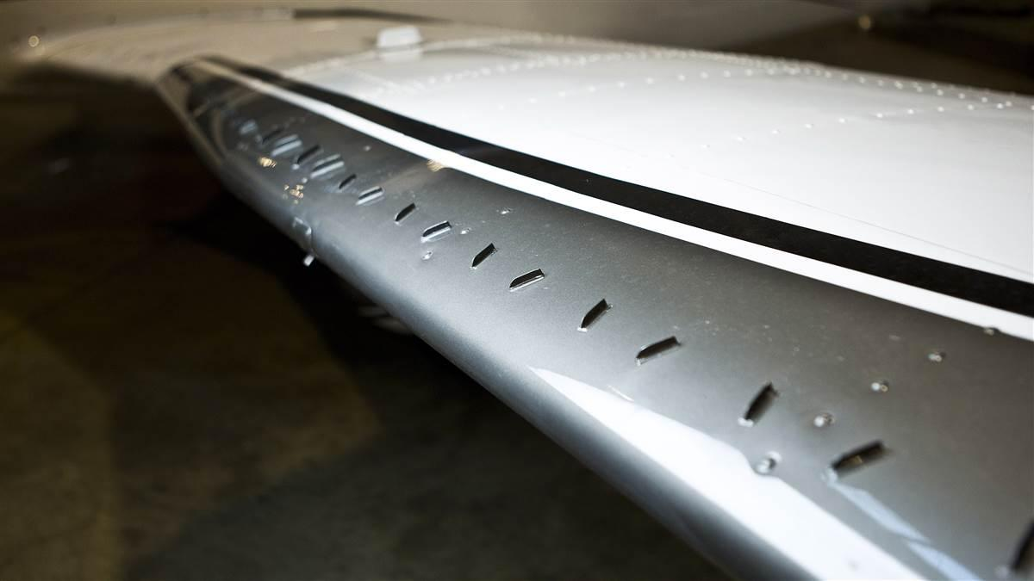
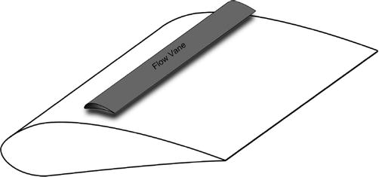
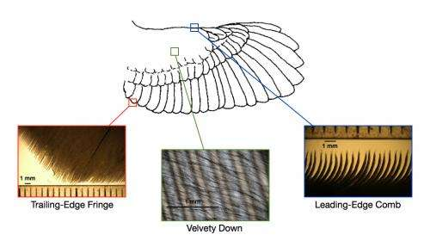
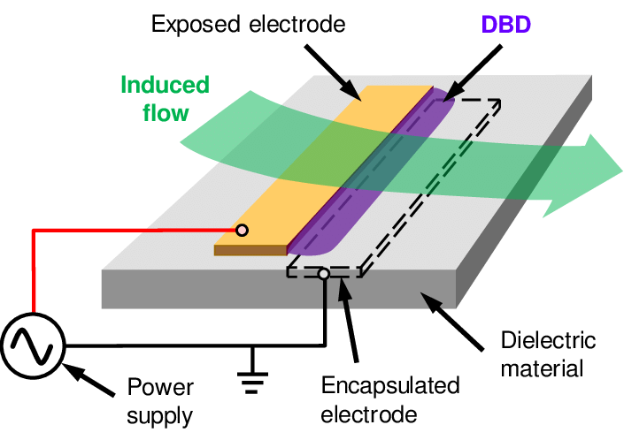
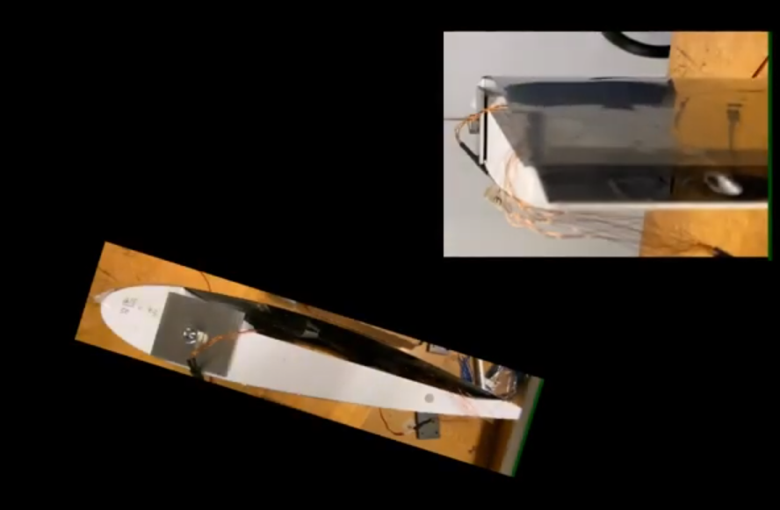
Quick Recap
Notes:
Drag reduction through flow control is a central issue for fluid dynamisicist and engineers, not just because it can save lots of fuel and money but also due to the fact that the area of active flow control has become very interdisciplinary in nature which continues to attract many people over the last few decades. Flow control can be achieved though passive or active methods. Passive methods usually include moving or non-moving mechanical parts such as vortex generators, or flow vanes, leading-edge serrations. But such passive methods do not give a control authority over the flow. On the other hand Active flow control methods give a high control authority over the flow. Some examples are Di-electric barrier discharge actuators for low speed control, surface morphing using piezo-electric actuators and there has also been studies using MHD actuators which induce lorentz force. Here in my course project, I have tried to dig deeper regarding the MHD flow control in poorly conducting flows such as seawater and it has three aspects to it.

Slide 3
Quick Recap
There are three aspects of flow control
Reduce the turbulent drag by suppressing turbulence or by laminarizing the turbulent flow
Delay transition by active wave cancellation
To control separated flows and shear layers
Notes:
Drag reduction through flow control is a central issue for fluid dynamisicist and engineers, not just because it can save lots of fuel and money but also due to the fact that the area of active flow control has become very interdisciplinary in nature which continues to attract many people over the last few decades. Flow control can be achieved though passive or active methods. Passive methods usually include moving or non-moving mechanical parts such as vortex generators, or flow vanes, leading-edge serrations. But such passive methods do not give a control authority over the flow. On the other hand Active flow control methods give a high control authority over the flow. Some examples are Di-electric barrier discharge actuators for low speed control, surface morphing using piezo-electric actuators and there has also been studies using MHD actuators which induce lorentz force. Here in my course project, I have tried to dig deeper regarding the MHD flow control in poorly conducting flows such as seawater and it has three aspects to it.

Slide 4
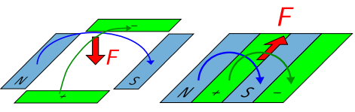
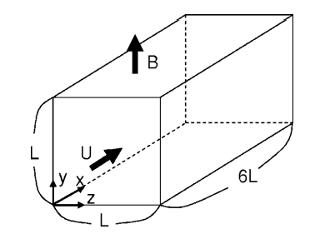
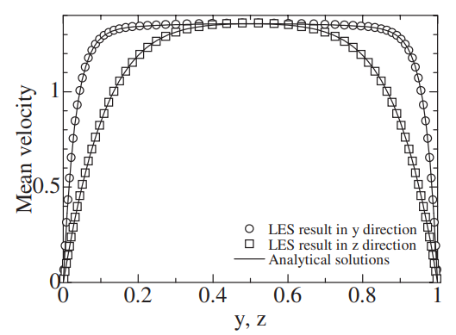
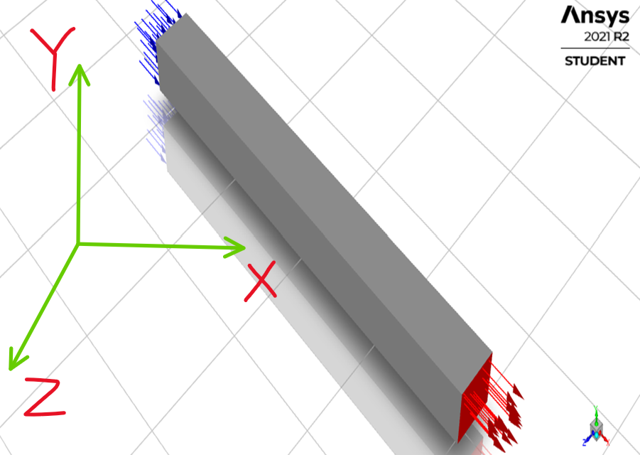
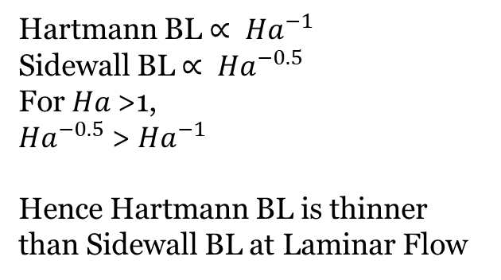
Literature Review of Previous Work
Hartmann BL $∝ {Ha}^{−1}$
Sidewall BL $∝ {Ha}^{−0.5}$
For $Ha$>1,
${Ha}^{−0.5}$ > ${Ha}^{−1}$
Hence Hartmann BL is thinner than Sidewall BL at Laminar Flow
Reference[2]: T Albrecht, T. Weier
Reference[1]: Hiromichi Kobayashi
LxL = 5x5 cm
Total Length = 75 cm
Reference[1]: Hiromichi Kobayashi
Notes:
So there three aspects of flow control but in the initial phase I will mainly be focusing on the first one which is to reduce the turbulent drag by suppressing turbulence or by laminarizing the turbulent flow. Researchers have tried different configurations of magnets in order to study the influence of the orientation of magnetic field on the boundary layer. The first one is the tile configuration which induces a normal force and the second one is called the stripe configuration which induces a streamwise or spanwise lorentz force. Numerical studies have shown that it is indeed possible to reduce the skin friction drag by 40%, for a similar experimental set-up only upto 10% reduction could be achieved due to various problems. So the first step was to simulate some bench mark problems that were found in the literature study. The physics of the problem is that there is a duct such that streamwise direction is the X-direction. Magnetic field is applied in the Y direction and it is observed that the velocity profile in Y direction and Z direction are different from each other. This is because in a duct flow there are 2 kinds of boundary layers, the BL perpendicular to the MF is the Hartmann BL and the BL parallel to the MF is the sidewall layer. The Hartmann layer is proportional to Ha^-1 and the sidewall is proportional to Ha−1/2 . Therefore, the Hartmann layer is thinner than the sidewall layer, due to this the velocity gradients are higher and the wall shear stress and skin friction coefficient increases. There are more results discussed in the paper, but I will leave them for now due to the interest of time.
. 2) Is to delay transition and 3) is control of separated flows.

Slide 5
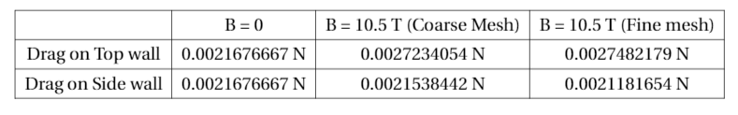
Grid Independence Test
Notes:
So there three aspects of flow control but in the initial phase I will mainly be focusing on the first one which is to reduce the turbulent drag by suppressing turbulence or by laminarizing the turbulent flow. Researchers have tried different configurations of magnets in order to study the influence of the orientation of magnetic field on the boundary layer. The first one is the tile configuration which induces a normal force and the second one is called the stripe configuration which induces a streamwise or spanwise lorentz force. Numerical studies have shown that it is indeed possible to reduce the skin friction drag by 40%, for a similar experimental set-up only upto 10% reduction could be achieved due to various problems. So the first step was to simulate some bench mark problems that were found in the literature study. The physics of the problem is that there is a duct such that streamwise direction is the X-direction. Magnetic field is applied in the Y direction and it is observed that the velocity profile in Y direction and Z direction are different from each other. This is because in a duct flow there are 2 kinds of boundary layers, the BL perpendicular to the MF is the Hartmann BL and the BL parallel to the MF is the sidewall layer. The Hartmann layer is proportional to Ha^-1 and the sidewall is proportional to Ha−1/2 . Therefore, the Hartmann layer is thinner than the sidewall layer, due to this the velocity gradients are higher and the wall shear stress and skin friction coefficient increases. There are more results discussed in the paper, but I will leave them for now due to the interest of time.
. 2) Is to delay transition and 3) is control of separated flows.

Slide 6
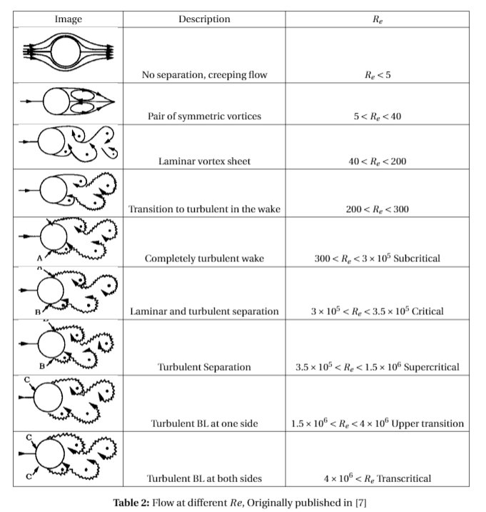
Flow over Cylinder
Notes:
So there three aspects of flow control but in the initial phase I will mainly be focusing on the first one which is to reduce the turbulent drag by suppressing turbulence or by laminarizing the turbulent flow. Researchers have tried different configurations of magnets in order to study the influence of the orientation of magnetic field on the boundary layer. The first one is the tile configuration which induces a normal force and the second one is called the stripe configuration which induces a streamwise or spanwise lorentz force. Numerical studies have shown that it is indeed possible to reduce the skin friction drag by 40%, for a similar experimental set-up only upto 10% reduction could be achieved due to various problems. So the first step was to simulate some bench mark problems that were found in the literature study. The physics of the problem is that there is a duct such that streamwise direction is the X-direction. Magnetic field is applied in the Y direction and it is observed that the velocity profile in Y direction and Z direction are different from each other. This is because in a duct flow there are 2 kinds of boundary layers, the BL perpendicular to the MF is the Hartmann BL and the BL parallel to the MF is the sidewall layer. The Hartmann layer is proportional to Ha^-1 and the sidewall is proportional to Ha−1/2 . Therefore, the Hartmann layer is thinner than the sidewall layer, due to this the velocity gradients are higher and the wall shear stress and skin friction coefficient increases. There are more results discussed in the paper, but I will leave them for now due to the interest of time.
. 2) Is to delay transition and 3) is control of separated flows.

Slide 7
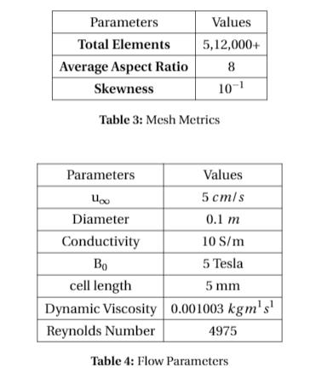
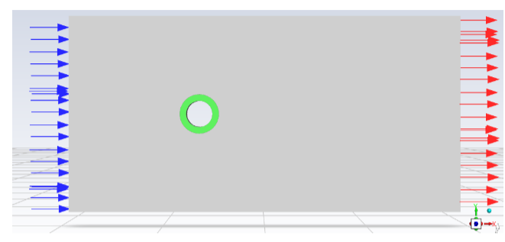
Flow over Cylinder
Notes:
So there three aspects of flow control but in the initial phase I will mainly be focusing on the first one which is to reduce the turbulent drag by suppressing turbulence or by laminarizing the turbulent flow. Researchers have tried different configurations of magnets in order to study the influence of the orientation of magnetic field on the boundary layer. The first one is the tile configuration which induces a normal force and the second one is called the stripe configuration which induces a streamwise or spanwise lorentz force. Numerical studies have shown that it is indeed possible to reduce the skin friction drag by 40%, for a similar experimental set-up only upto 10% reduction could be achieved due to various problems. So the first step was to simulate some bench mark problems that were found in the literature study. The physics of the problem is that there is a duct such that streamwise direction is the X-direction. Magnetic field is applied in the Y direction and it is observed that the velocity profile in Y direction and Z direction are different from each other. This is because in a duct flow there are 2 kinds of boundary layers, the BL perpendicular to the MF is the Hartmann BL and the BL parallel to the MF is the sidewall layer. The Hartmann layer is proportional to Ha^-1 and the sidewall is proportional to Ha−1/2 . Therefore, the Hartmann layer is thinner than the sidewall layer, due to this the velocity gradients are higher and the wall shear stress and skin friction coefficient increases. There are more results discussed in the paper, but I will leave them for now due to the interest of time.
. 2) Is to delay transition and 3) is control of separated flows.

Slide 8
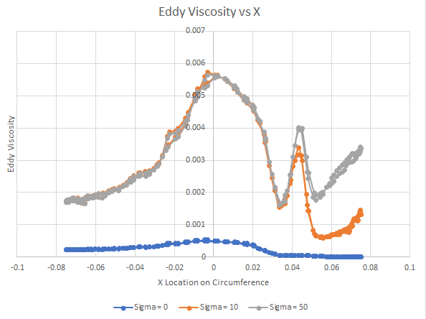
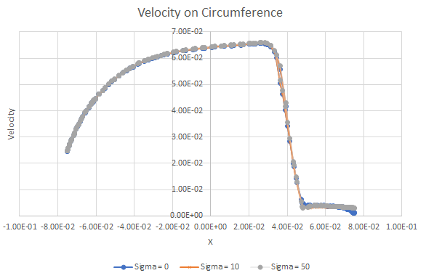
Results: Flow over Cylinder
Notes:
So there three aspects of flow control but in the initial phase I will mainly be focusing on the first one which is to reduce the turbulent drag by suppressing turbulence or by laminarizing the turbulent flow. Researchers have tried different configurations of magnets in order to study the influence of the orientation of magnetic field on the boundary layer. The first one is the tile configuration which induces a normal force and the second one is called the stripe configuration which induces a streamwise or spanwise lorentz force. Numerical studies have shown that it is indeed possible to reduce the skin friction drag by 40%, for a similar experimental set-up only upto 10% reduction could be achieved due to various problems. So the first step was to simulate some bench mark problems that were found in the literature study. The physics of the problem is that there is a duct such that streamwise direction is the X-direction. Magnetic field is applied in the Y direction and it is observed that the velocity profile in Y direction and Z direction are different from each other. This is because in a duct flow there are 2 kinds of boundary layers, the BL perpendicular to the MF is the Hartmann BL and the BL parallel to the MF is the sidewall layer. The Hartmann layer is proportional to Ha^-1 and the sidewall is proportional to Ha−1/2 . Therefore, the Hartmann layer is thinner than the sidewall layer, due to this the velocity gradients are higher and the wall shear stress and skin friction coefficient increases. There are more results discussed in the paper, but I will leave them for now due to the interest of time.
. 2) Is to delay transition and 3) is control of separated flows.

Slide 9
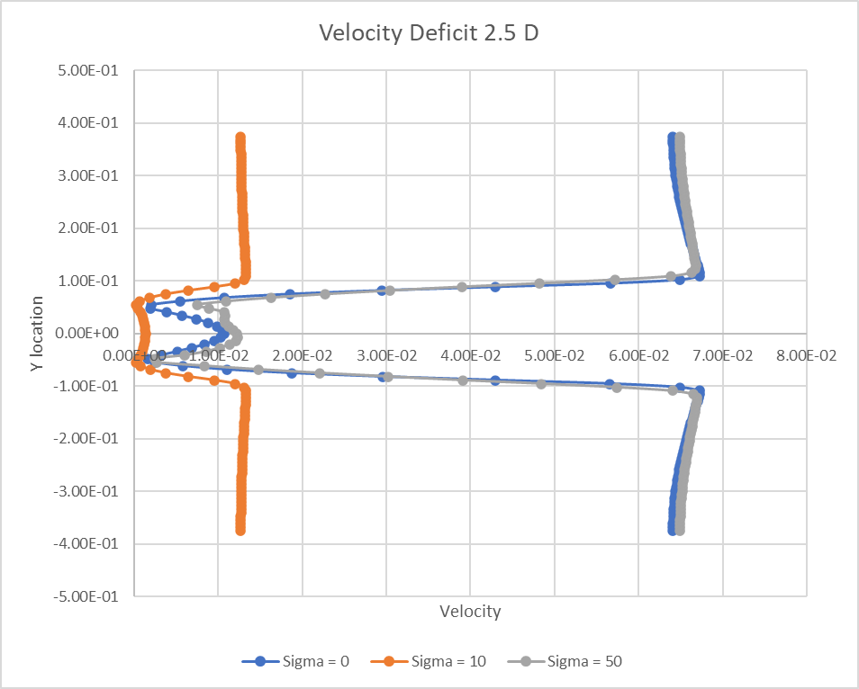
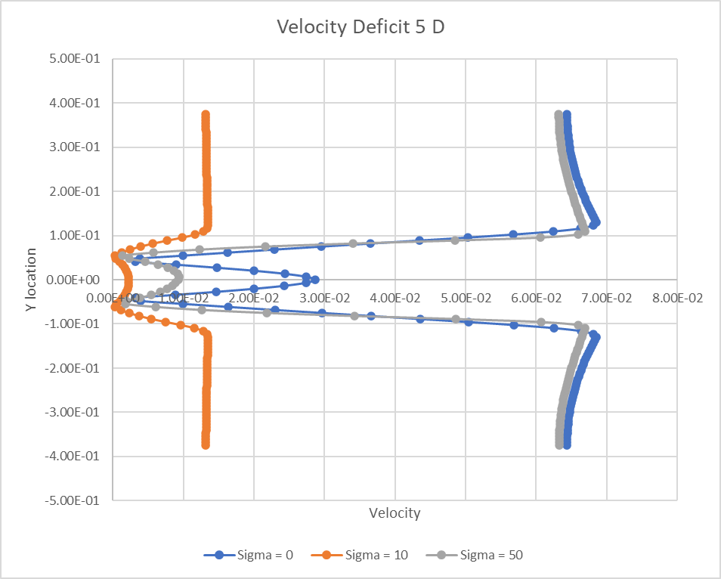
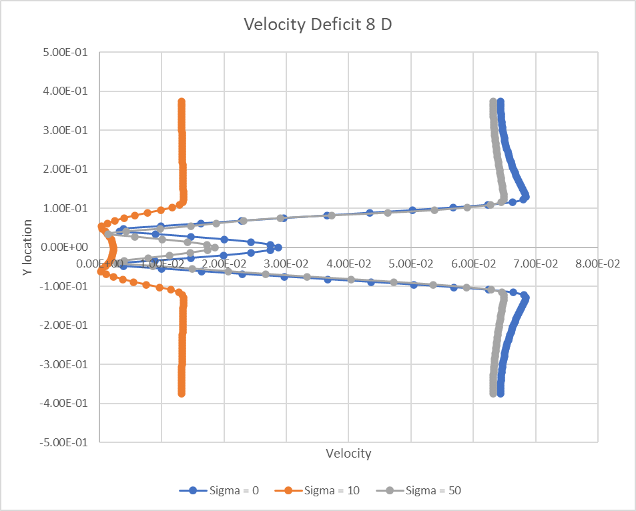
Results: Flow over Cylinder
Interaction number = 0.5
Interaction number = 2.5
Conclusion: For interaction number N~1, drag is the lowest
Notes:
So there three aspects of flow control but in the initial phase I will mainly be focusing on the first one which is to reduce the turbulent drag by suppressing turbulence or by laminarizing the turbulent flow. Researchers have tried different configurations of magnets in order to study the influence of the orientation of magnetic field on the boundary layer. The first one is the tile configuration which induces a normal force and the second one is called the stripe configuration which induces a streamwise or spanwise lorentz force. Numerical studies have shown that it is indeed possible to reduce the skin friction drag by 40%, for a similar experimental set-up only upto 10% reduction could be achieved due to various problems. So the first step was to simulate some bench mark problems that were found in the literature study. The physics of the problem is that there is a duct such that streamwise direction is the X-direction. Magnetic field is applied in the Y direction and it is observed that the velocity profile in Y direction and Z direction are different from each other. This is because in a duct flow there are 2 kinds of boundary layers, the BL perpendicular to the MF is the Hartmann BL and the BL parallel to the MF is the sidewall layer. The Hartmann layer is proportional to Ha^-1 and the sidewall is proportional to Ha−1/2 . Therefore, the Hartmann layer is thinner than the sidewall layer, due to this the velocity gradients are higher and the wall shear stress and skin friction coefficient increases. There are more results discussed in the paper, but I will leave them for now due to the interest of time.
. 2) Is to delay transition and 3) is control of separated flows.

Slide 10
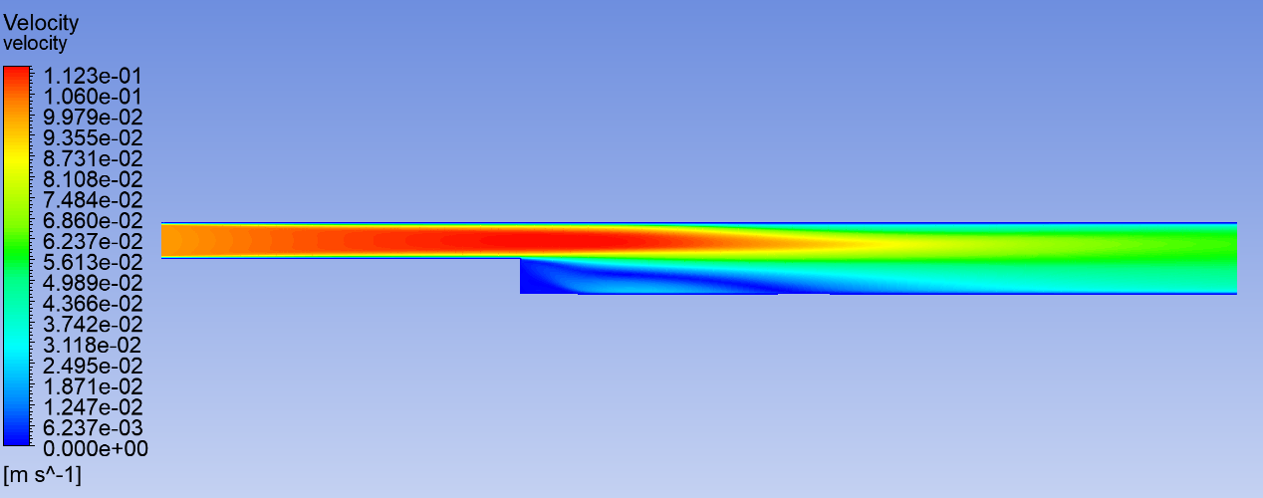
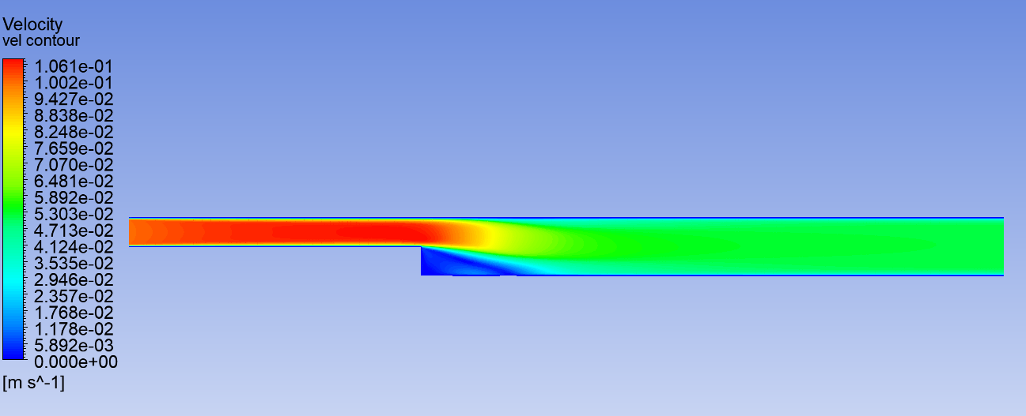
Flow over a Backward Step
Notes:
So there three aspects of flow control but in the initial phase I will mainly be focusing on the first one which is to reduce the turbulent drag by suppressing turbulence or by laminarizing the turbulent flow. Researchers have tried different configurations of magnets in order to study the influence of the orientation of magnetic field on the boundary layer. The first one is the tile configuration which induces a normal force and the second one is called the stripe configuration which induces a streamwise or spanwise lorentz force. Numerical studies have shown that it is indeed possible to reduce the skin friction drag by 40%, for a similar experimental set-up only upto 10% reduction could be achieved due to various problems. So the first step was to simulate some bench mark problems that were found in the literature study. The physics of the problem is that there is a duct such that streamwise direction is the X-direction. Magnetic field is applied in the Y direction and it is observed that the velocity profile in Y direction and Z direction are different from each other. This is because in a duct flow there are 2 kinds of boundary layers, the BL perpendicular to the MF is the Hartmann BL and the BL parallel to the MF is the sidewall layer. The Hartmann layer is proportional to Ha^-1 and the sidewall is proportional to Ha−1/2 . Therefore, the Hartmann layer is thinner than the sidewall layer, due to this the velocity gradients are higher and the wall shear stress and skin friction coefficient increases. There are more results discussed in the paper, but I will leave them for now due to the interest of time.
. 2) Is to delay transition and 3) is control of separated flows.

Slide 11
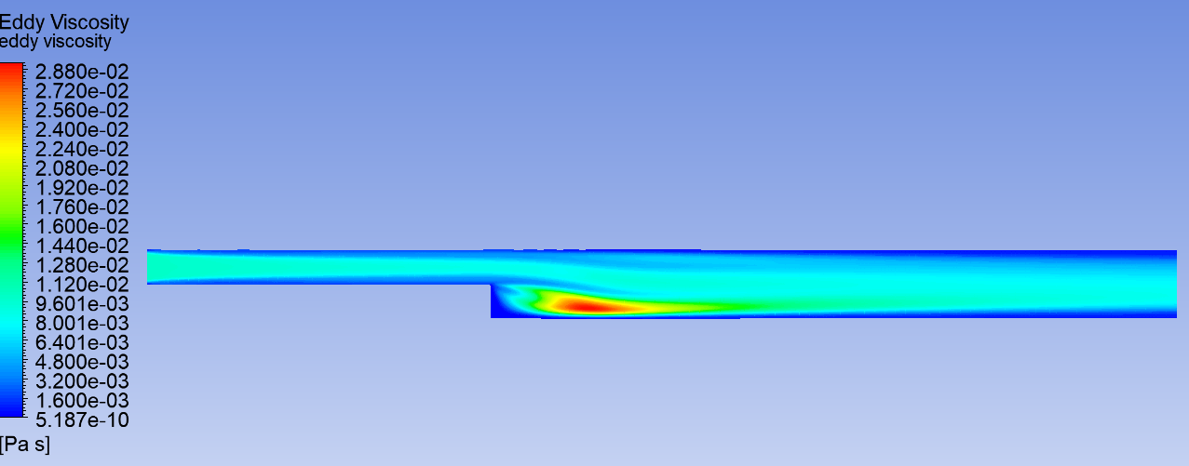
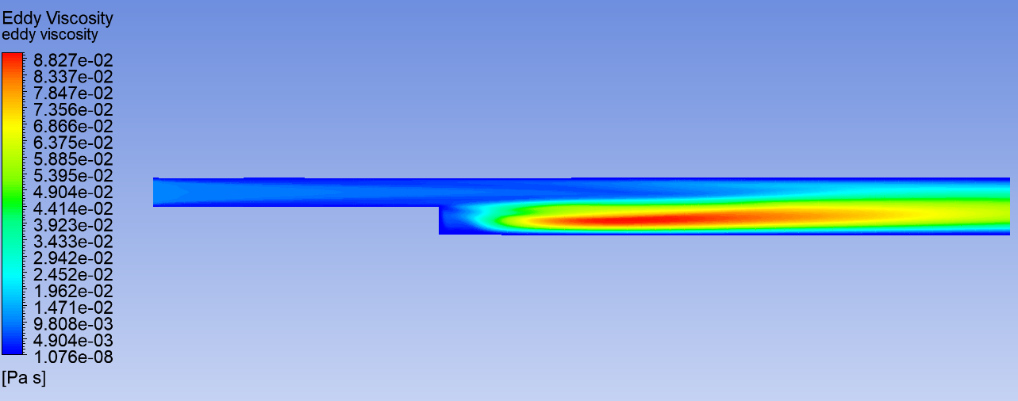
Flow over a Backward Step
Notes:
So there three aspects of flow control but in the initial phase I will mainly be focusing on the first one which is to reduce the turbulent drag by suppressing turbulence or by laminarizing the turbulent flow. Researchers have tried different configurations of magnets in order to study the influence of the orientation of magnetic field on the boundary layer. The first one is the tile configuration which induces a normal force and the second one is called the stripe configuration which induces a streamwise or spanwise lorentz force. Numerical studies have shown that it is indeed possible to reduce the skin friction drag by 40%, for a similar experimental set-up only upto 10% reduction could be achieved due to various problems. So the first step was to simulate some bench mark problems that were found in the literature study. The physics of the problem is that there is a duct such that streamwise direction is the X-direction. Magnetic field is applied in the Y direction and it is observed that the velocity profile in Y direction and Z direction are different from each other. This is because in a duct flow there are 2 kinds of boundary layers, the BL perpendicular to the MF is the Hartmann BL and the BL parallel to the MF is the sidewall layer. The Hartmann layer is proportional to Ha^-1 and the sidewall is proportional to Ha−1/2 . Therefore, the Hartmann layer is thinner than the sidewall layer, due to this the velocity gradients are higher and the wall shear stress and skin friction coefficient increases. There are more results discussed in the paper, but I will leave them for now due to the interest of time.
. 2) Is to delay transition and 3) is control of separated flows.

Slide 12
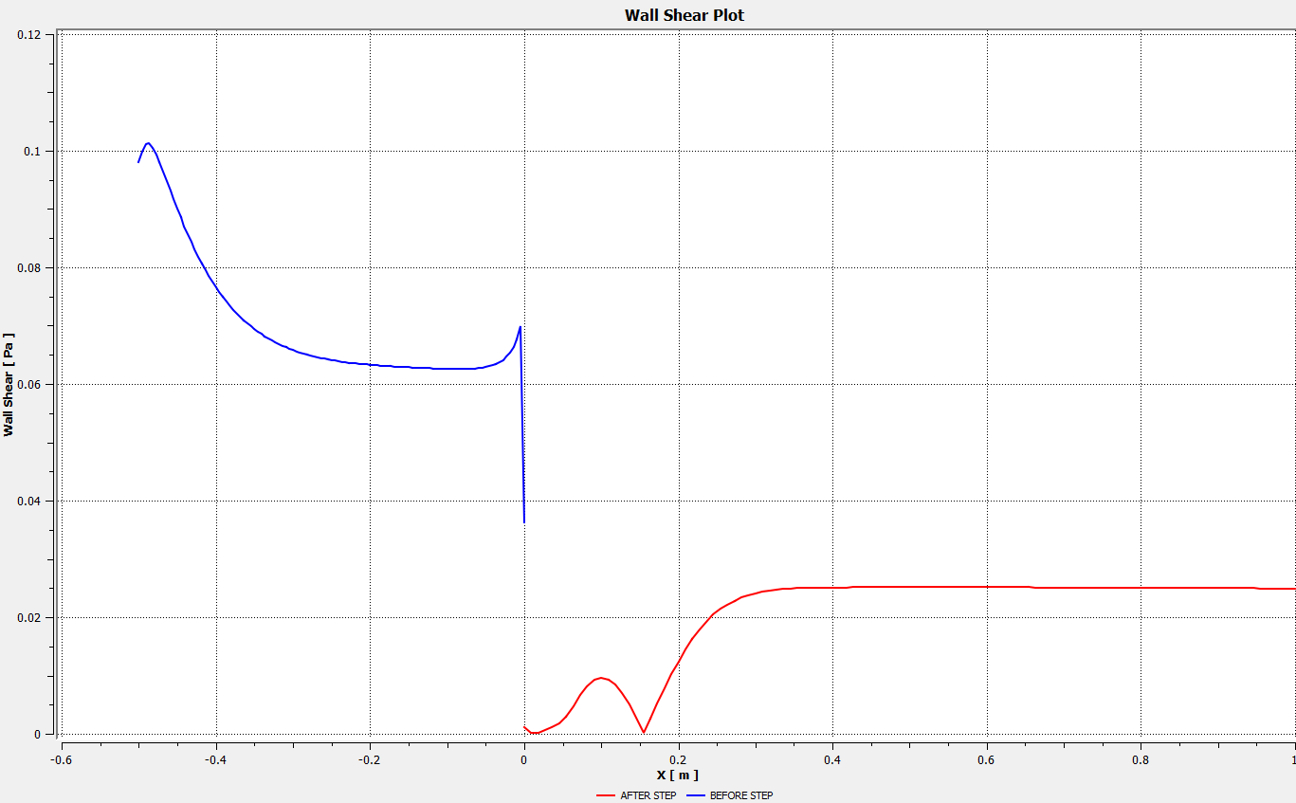
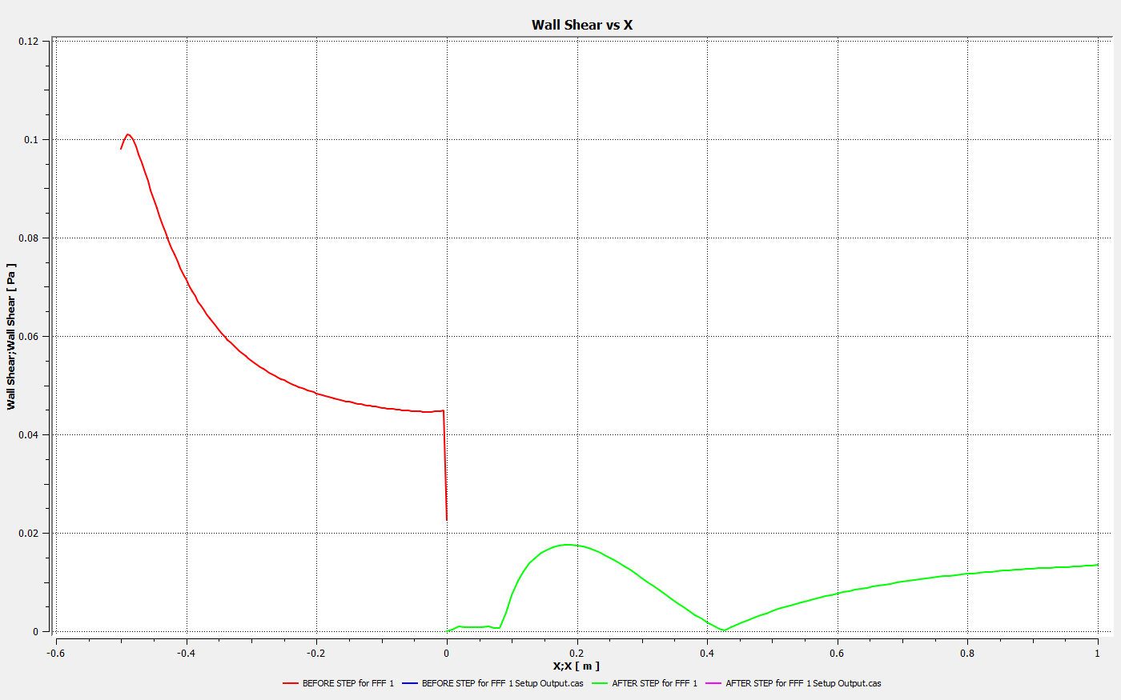
Flow over a Backward Step
Sigma = 10
Sigma = 0
Notes:
So there three aspects of flow control but in the initial phase I will mainly be focusing on the first one which is to reduce the turbulent drag by suppressing turbulence or by laminarizing the turbulent flow. Researchers have tried different configurations of magnets in order to study the influence of the orientation of magnetic field on the boundary layer. The first one is the tile configuration which induces a normal force and the second one is called the stripe configuration which induces a streamwise or spanwise lorentz force. Numerical studies have shown that it is indeed possible to reduce the skin friction drag by 40%, for a similar experimental set-up only upto 10% reduction could be achieved due to various problems. So the first step was to simulate some bench mark problems that were found in the literature study. The physics of the problem is that there is a duct such that streamwise direction is the X-direction. Magnetic field is applied in the Y direction and it is observed that the velocity profile in Y direction and Z direction are different from each other. This is because in a duct flow there are 2 kinds of boundary layers, the BL perpendicular to the MF is the Hartmann BL and the BL parallel to the MF is the sidewall layer. The Hartmann layer is proportional to Ha^-1 and the sidewall is proportional to Ha−1/2 . Therefore, the Hartmann layer is thinner than the sidewall layer, due to this the velocity gradients are higher and the wall shear stress and skin friction coefficient increases. There are more results discussed in the paper, but I will leave them for now due to the interest of time.
. 2) Is to delay transition and 3) is control of separated flows.

Slide 13
References
[1] Hiromichi Kobayashi “Large eddy simulation of magnetohydrodynamic turbulent duct flows”, Fluids 20, 015102 (2008); Submitted: 02 August 2007 . Accepted: 24 November 2007 . Published Online: 25 January 2008
[2] T. Albrecht, J. Stiller, H. Metzkes, T. Weier, and G. Gerbeth ”Electromagnetic flow control in poor conductor”, Eur. Phys. J. Special Topics 220, 275–285 (2013) © EDP Sciences, Springer-Verlag 20

